Slide 1
Scenario W: EMG Sensor with Audiovisual output
Group 9:
Franky saxena
Bruno calogero
Daniel saul
Theo Velon
PLACE FINAL DESIGN HERE

Slide 2
Amplification/Gain stage
Add your first bullet point here
Add your second bullet point here
Add your third bullet point here

Slide 3
Filtering Stage
Add your first bullet point here
Add your second bullet point here
Add your third bullet point here

Slide 4
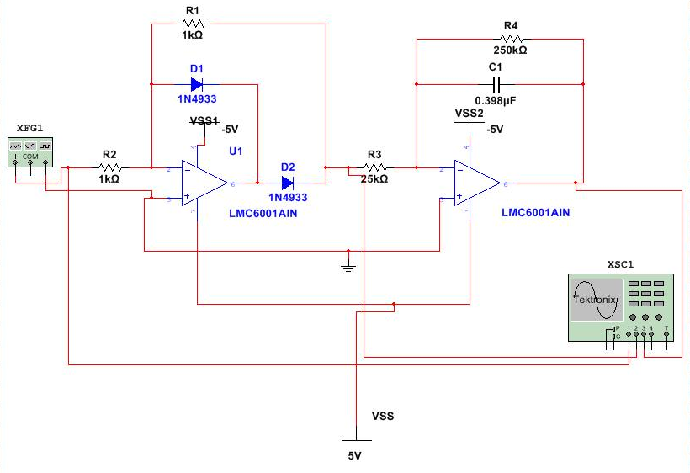
Rectifier/Integrator
Notes:
The output of the high pass filter is the input to the rectifier. The rectifier is used to eliminate the negative signal so that the arduino can read the signal. We used a half wave rectifier which was the model of the superdiode circuit. Then the output of the rectifier is fed into the integrator.

Slide 5
ADC/Microcontroller
Add your first bullet point here
Add your second bullet point here
Add your third bullet point here

